Slide 2
Physical activity

Slide 3
Objectives
You can identify factors that affect your physical activity and sleep.
You can assess the significance of physical activity and sleep in terms of your health.
You can provide justified suggestions about how to maintain health-promoting lifestyles and prevent those that endanger health.
You can prepare a diverse plan to promote your health and well-being, taking into consideration the importance of physical activity, recovery and sleep in terms of maintaining the ability to study and work.
You can realistically assess implementation of the plan and achievement of the goals.

Slide 4
Lesson 1 Physical activity Benefits of physical activity Sedentary behaviour Physical activity recommendation

Slide 5
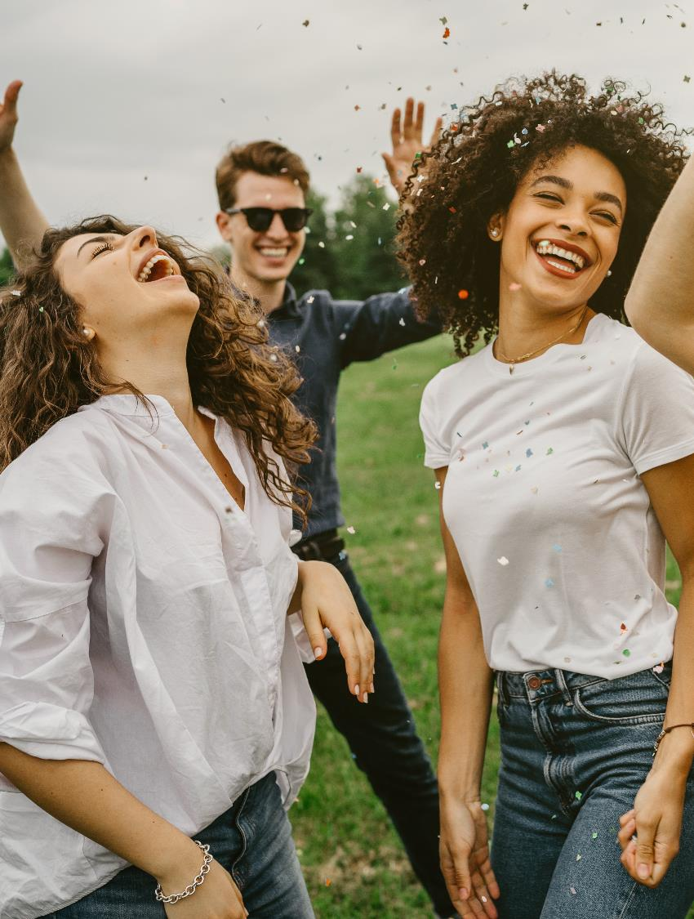
Discuss together
What is physical activity?
What kind of physical activity do you like?

Slide 6
What is physical activity?
Physical activity = all types of everyday activity, such as
games
physical activity during the school day
everyday activities during leisure time, such as physical activity and sport hobbies, housework
active movement from one place to another, for example, walking, cycling or by wheelchair
Physical activity = all activity that consumes more energy than sedentary behaviour.

Slide 7
Why should we be physically active?
62 Smart Moves - All physical activity is a positive step - YouTube

Slide 8
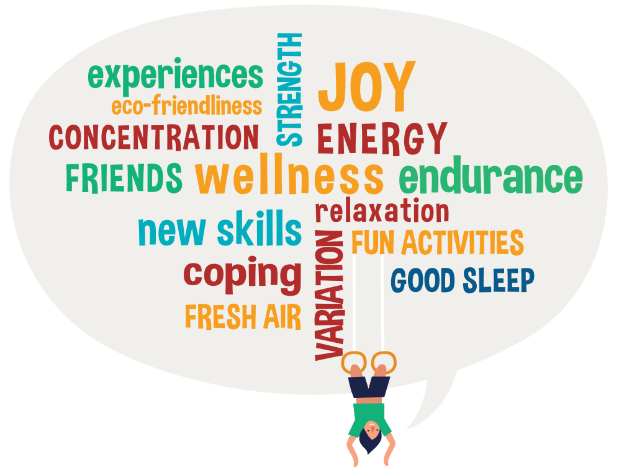
What could physical activity do for you?
Notes:
Toiminnallinen opetusidea: BINGO

Slide 9
The benefits of physical activity
Write down the benefits of physical activity on, for example, a Padlet wall. You can examine the topic from the following angles:
physical well-being
psychological well-being
social well-being
learning
diseases
Complete the list together.
More information in Finnish

Slide 18
Discuss together
How do long periods of sitting or other sedentary behaviour affect your body and mind? How do you feel afterwards?
Studies show that students sit for an average of 9–10 hours per day. How much time do you think you spend sitting?

Slide 19
Sedentary behaviour is like poison for your body
Long periods of sedentary behaviour are a real physical challenge for our bodies. They may expose people to various symptoms in the musculoskeletal system, such as neck and shoulder area symptoms.
Long periods of sedentary behaviour are also a health risk in terms of developing various cardiac and metabolic diseases.

Slide 20
How do long periods of sitting or sedentary behaviour affect our health?
Sitting slows the blood circulation in your body, also in the brain. It can also cause headache and slow your thinking.
Sitting causes monotonous strain on the body and may lead to aches and tension in, for example, the neck-shoulder area and in the back.
Your joints may become stiff.
A lifestyle of sitting puts strain on the lower back structures and slows their metabolism. You may feel this as stiffness or a throbbing sensation.
Sitting causes swelling in the legs because blood flow from the veins to the heart slows down.

Slide 21
It’s always a good idea to take breaks in sedentary behaviour
All physical activity is a positive step!
It’s important to take breaks in sitting during lessons– this keeps both mind and body alert throughout the lesson.
Plan your own exercise breaks or try an exercise break from a video.
Start using the BREAK PRO exercise break application
What would be pleasant ways for the whole group to reduce sedentary behaviour and increase movement during the school day? Choose one of these and make it a habit!
62 Smart Moves - Boxing gets your body moving - YouTube

Slide 22
Physical activity recommen-dation for 7–17-year-olds
Physical activity recommendation for children and adolescents – Pyry and Aida’s day

Slide 23
Active quiz - Stand up. - March in place between the answers.

Slide 24
How many hours of moderate and vigorous physical activity is recommended for 7–17-year-olds each day?
A) 1 h
B) 2 h
C) 3 h
Answer by doing the same number of burpees (go to the push-up position and then jump up) that corresponds to the hours.

Slide 25
Correct answer
How many hours of moderate and vigorous physical activity is recommended for 7–17-year-olds each day?
A) 1 h
B) 2 h
C) 3 h
You should get at least one hour of moderate or vigorous physical activity each day.

Slide 26
2. According to the recommendation, how many times per week should 7–17-year-olds be physically active in order to improve endurance?
A) 2 times
B) 3 times
C) 4 times
Answer by doing one squat for each physical activity session.

Slide 27
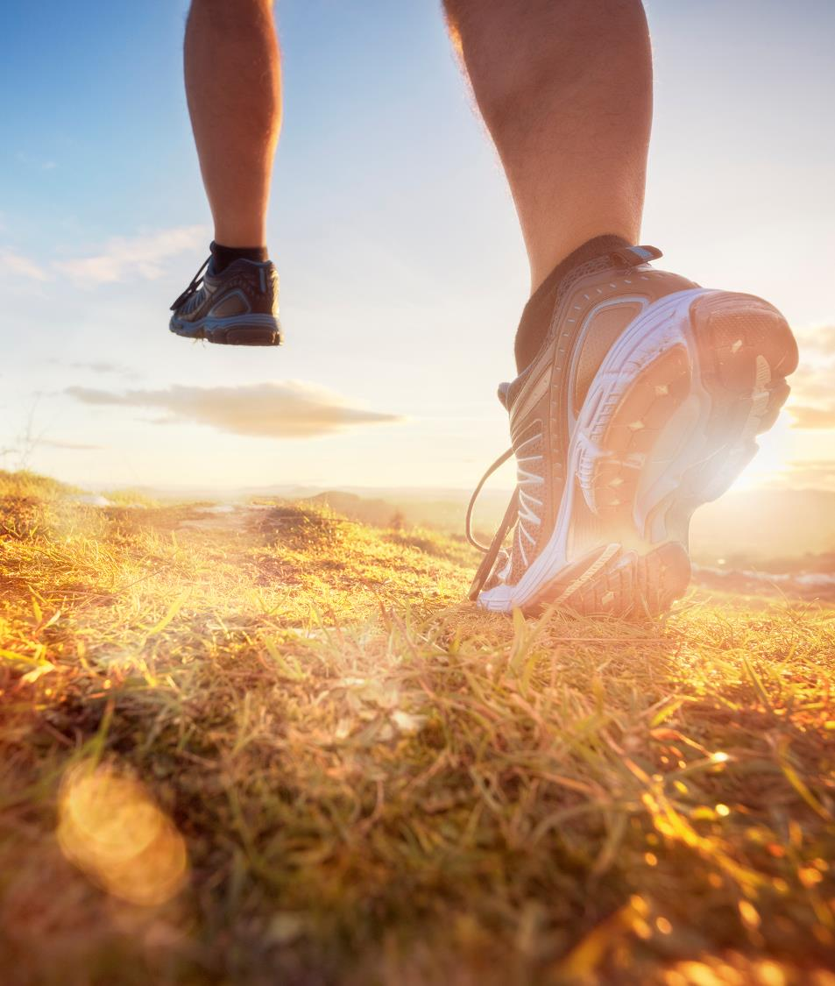
Correct answer
2. According to the recommendation, how many times per week should 7–17-year-olds be physically active in order to improve endurance?
A) 2 times
B) 3 times
C) 4 times
7–17-year-olds should be physically active in a way that improves endurance at least 3 times per week.

Slide 28
3. According to the recommendation, how many times per week should 7–17-year-olds be physically active in a way that strengthens muscles and bones?
A) 1 time
B) 2 times
C) 3 times
Answer by doing one push-up for each physical activity session.

Slide 29
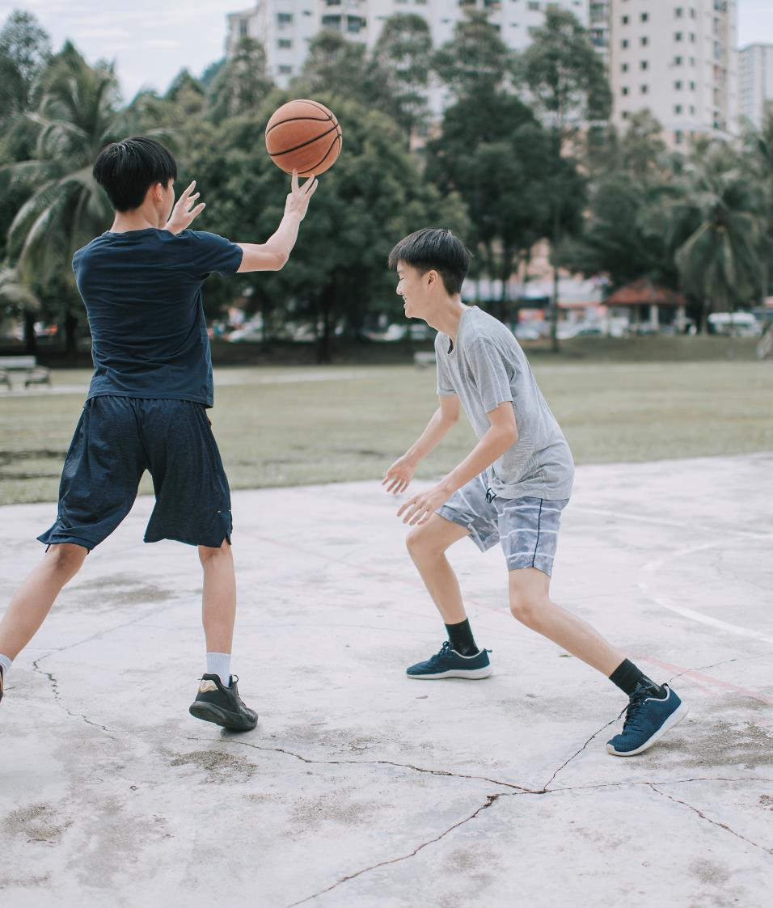
Correct answer
3. According to the recommendation, how many times per week should 7–17-year-olds be physically active in a way that strengthens muscles and bones?
A) 1 time
B) 2 times
C) 3 times
7–17-year-olds should be physically active in a way that strengthens muscles and bones at least 3 times per week.

Slide 30
4. It’s a good idea to take breaks in sedentary behaviour, for example, by walking around or taking an exercise break.
A) Correct
B) Incorrect
If you answer A), do 10 side stretches.
If you answer B), do 10 squat jumps.

Slide 31
Correct answer
4. It’s a good idea to take breaks in sedentary behaviour, for example, by walking around or taking an exercise break.
A) Correct
B) Incorrect
It’s a good idea to take breaks during long periods of sedentary behaviour in order to remain alert.

Slide 32
5. You can increase your own physical activity with everyday physical activity, such as walking or cycling to school and hobbies more often or choosing to use the stairs instead of taking the lift.
A) Correct
B) Incorrect
If you answer A), do 10 side-to-side body rotations.
If you answer B), rotate your hands 10 times.

Slide 33
Correct answer
5. You can increase your own physical activity with everyday physical activity, such as walking or cycling to school and hobbies more often or choosing to use the stairs instead of taking the lift.
A) Correct
B) Incorrect
Being active whenever you can will make you feel better.

Slide 34
Physical activity recommendation for 7–17-year-olds
Read more
You can use the prepared presentation material

Slide 35
Light, moderate and vigorous physical activity
With a pair, find the difference between light, moderate and vigorous physical activity.
Use different sources, for example:
Recommendation on physical activity for children and adolescents aged 7–17 years
Physical fitness and work ability - Smart Moves (in Finnish)

Slide 36
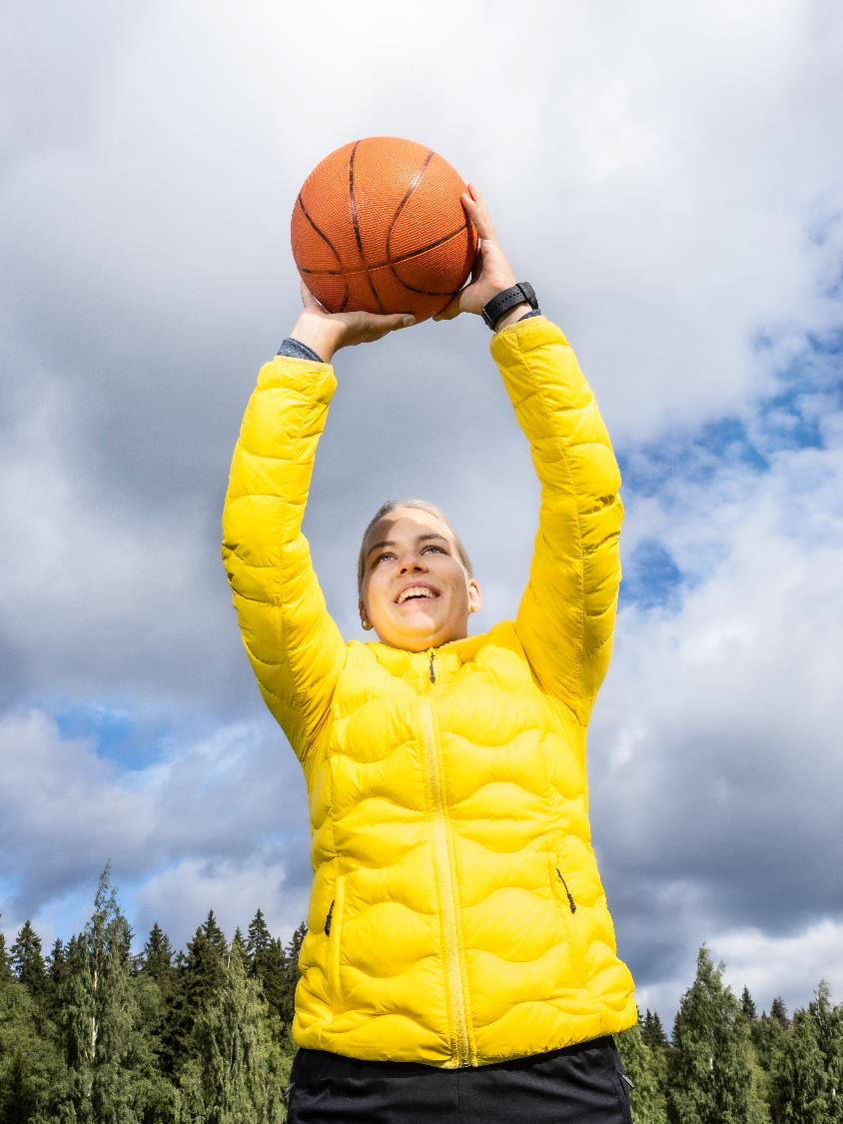
Physical activity to improve endurance
Vigorous physical activity improves endurance and cardiovascular function
Vigorous physical activity
produces greater health impacts in the body than lighter physical activity
strengthens the heart muscle
improves blood circulation
increases oxygen use efficiency

Slide 37
Physical activity to strengthen your muscles and bones
This type of physical activity is important in order to develop and maintain muscular fitness.
for example, body weight training, gym workouts and group fitness, stair climbing
Different types of jumps and quick directional changes strengthen the bones.
For example, gym classes and fast-paced ball games
The bones of people who are physically active contain more minerals and have a stronger structure in comparison to people who are less active.

Slide 38
Research data on the physical activity of young people
LIITU report 2020 & LIITU report 2022
What are the reasons for physical activity or lack of physical activity?
What would inspire young people to be physically active?

Slide 39
Diary
Record your physical activity and sleep for one week using the paper or electronic diary template: Diary for monitoring physical activity and sleep - UKK-instituutti (ukkinstituutti.fi)
After one week has passed, check your habits using the online physical activity questionnaire.

Slide 40
Lesson 2 My physical activity Physical activity and safety Physical activity and working life

Slide 41
My physical activity
Compare your habits to the physical activity recommendation:
Physical activity questionnaire for people under 18:
PA Questionnaire - UKK Institute (ukkinstituutti.fi)
Assess your activity -online app for people over 18:
Assess your activity online app

Slide 42
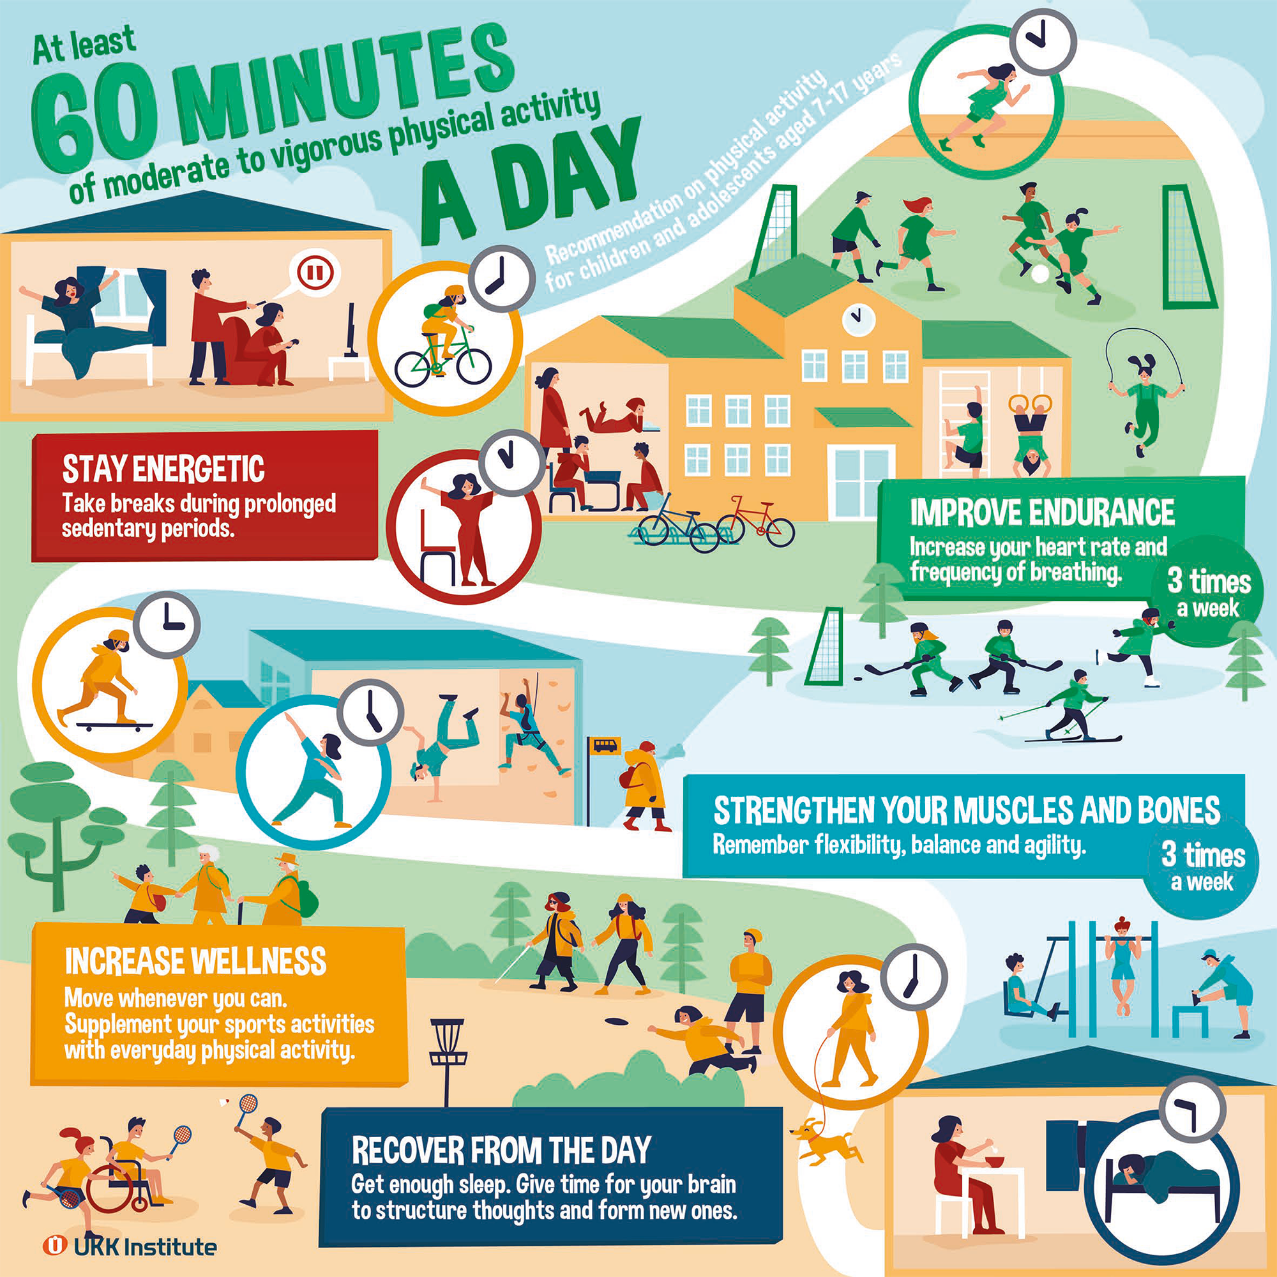
My physical activity during the week
Look at the bar graph in the online questionnaire summary view and compare it to the physical activity recommendation.
Also check the summaries of physical activity to improve endurance, physical activity to strength muscles and bones, and taking breaks in sedentary behaviour.
What comes to mind regarding your physical activity?

Slide 43
My sleep during the week
Look at the bar graph showing how much you sleep in the online questionnaire summary view.
Independent reflection:
Did you wake up in the morning feeling rested and alert?
What comes to mind regarding the amount of sleep you get?

Slide 44
Plan for the future
Independent reflection:
Compare your habits with the physical activity recommendation. Which areas of the physical activity recommendation do you think you’re already doing well in? What do you want to maintain?
Choose a development goal. Is there an area in which you would like to see a change? What could you do to improve the situation?
Make a plan. Can you think of one small act that would help you reach your goal?

Slide 45
Make a plan for increasing physical activity or sleep
Fill in the planning template: Plan for improving physical activity or sleep - UKK-instituutti (ukkinstituutti.fi)

Slide 46
SMART goals
S = Specific
M = Measurable
A = Achievable
R = Relevant
T = Time-bound

Slide 47
Brain break!
Smart Moves: Brain break (hands) - YouTube

Slide 48
Physical activity and safety Can physical activity have negative effects?
Go to the Smart Moves website (in Finnish) and look for answers to the following questions:
What causes acute injuries, stress-related injuries and overtraining?
How can injuries be prevented during physical activity?
What factors enhance recovery in physically active people?

Slide 49
First aid and treatment of sports injuries
The guidelines for first aid and treatment related to sports injuries have been updated.
The previous ICE first aid guidelines (ice-compression-elevation) have been replaced by the new PEACE guidelines.
A completely new element in the recommendation for treating sports injuries is the LOVE guidelines for rehabilitation measures in the days following first aid.
Learn more about the new guidelines and then play the ActionTrack game, which includes an assignment folder on first aid and treatment of sports injuries.
More information about treating sports injuries in Finnish

Slide 50
Physical activity and working life

Slide 51
Occupational capacity
In addition to solid job-related skills, an employee needs occupational capacity in order to cope with working in their profession.
Watch the Smart Moves video ”Virtaa ja voimaa tulevalle ammattilaiselle” (Energy and strength for professionals).

Slide 52
Reflect
What kind of occupational capacity is needed in your field?
Does your future job involve heavy physical work, a lot of standing or a lot of sitting?
Read the tips on break exercises for vocational students
Ergonomics can be used to plan a work environment that does not put excess strain on the body. See more:
Ergonomics tips for people doing heavy physical work (in Finnish)
Ergonomics tips for standing workers (in Finnish)
Ergonomics tips for for sitting and standing workstations (in Finnish)

Slide 53
How can a person maintain health-promoting lifestyles and prevent those that endanger health?
Based on the WHO health promotion model, consider examples of actions that could promote physical activity among the population.
Build healthy public policy to promote physical activity
Create supportive environments for health and physical activity
Re-orient health services
Strengthen community action for health
Develop personal skills
Or a reflection assignment on how to increase physical activity and reduce sedentary behaviour at workplaces and educational institutions

Slide 54
Thank you!

